Slide 1

Analysis of Government Spending
Shreya Nayak, Akhil Jain, Jiaye(Andy) Wang
Team 7

Slide 2
Motivation and Objective
Analyze historical trends in public spending
Compare countries based on money spent per person
Analyze priorities of various governments
Find correlations between:
- Health Expenditure and Life Expectancy
- Social Expenditure and Poverty Rate
- Education Expenditure and Literacy Rate
- Gross Domestic Product per capita and Happiness index

Slide 3
Methodology
OECD
World Bank
UNESCO
IMF
Pandas DataFrames
Filtering
Formating
Merging
Matplotlib
Bokeh
Folium

Slide 4
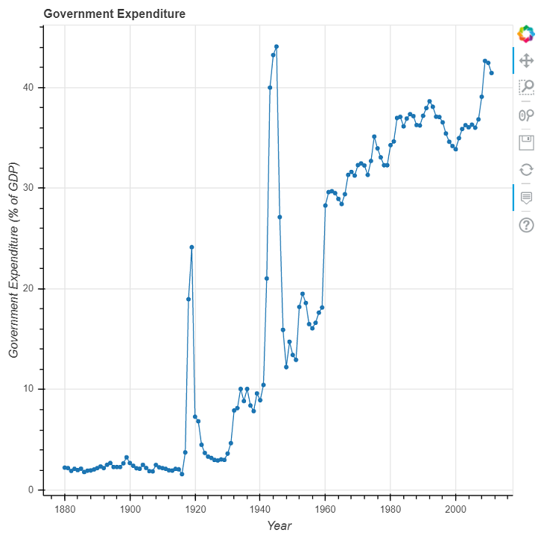
Trend in government expenditure over the years
General upward trend
Volatility during World Wars(1915-1945)
Fast growth (1945-1980)

Slide 5
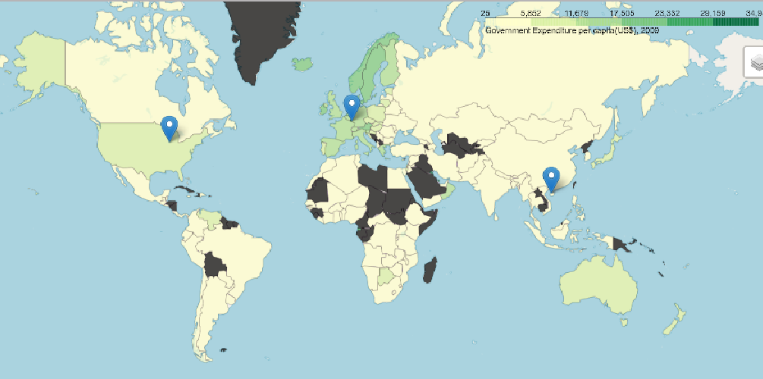
Comparison of Government Expenditure per capita (Year 2009)
Government Expenditure per capita (US$)
European Countries spend maximum
Asian Countries spend least

Slide 6
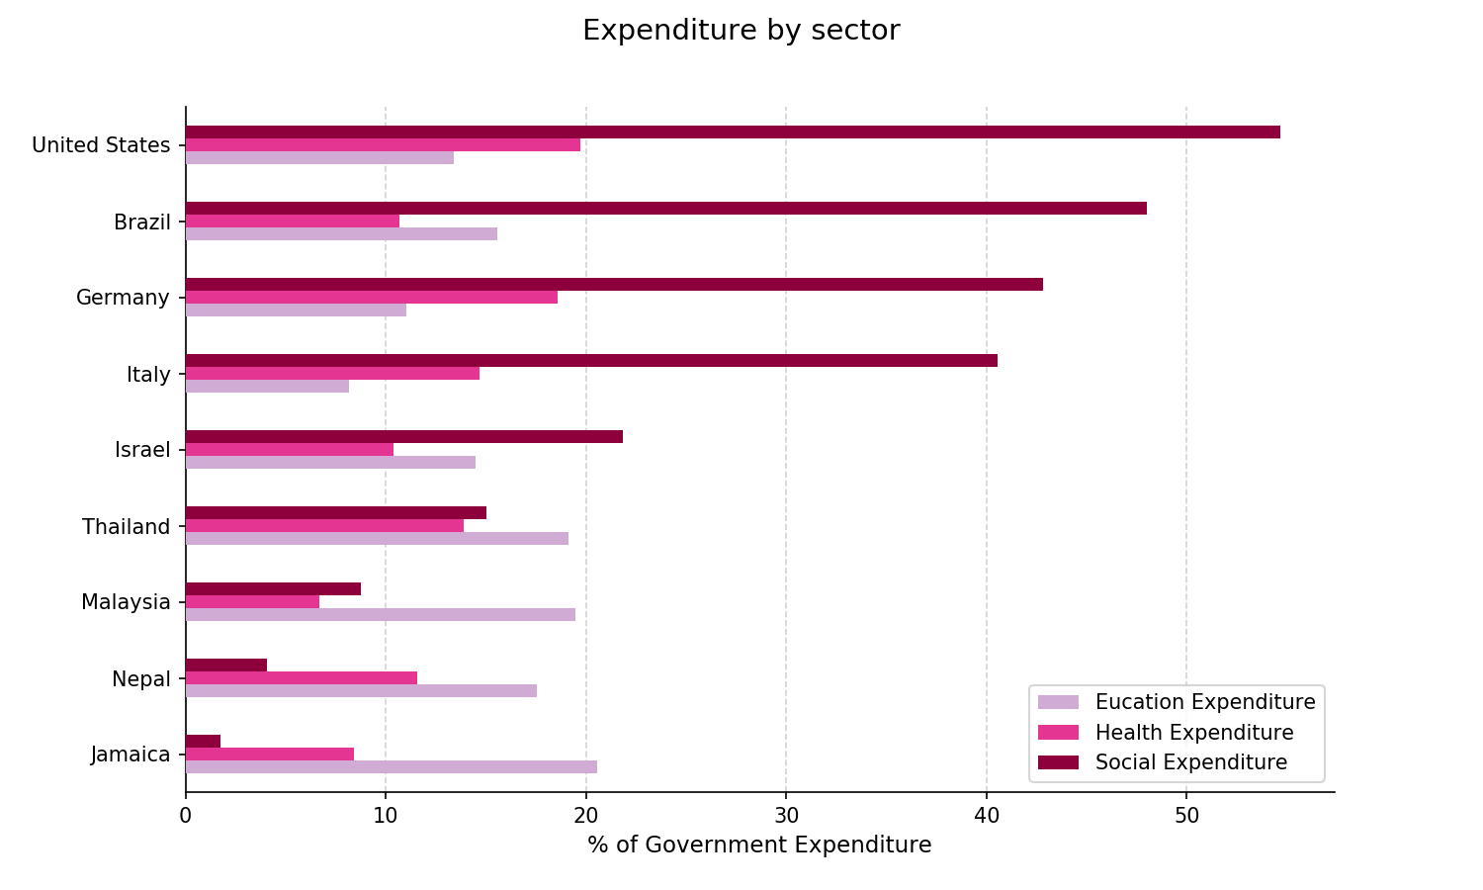
Comparison of Expenditure by Sector

Slide 7
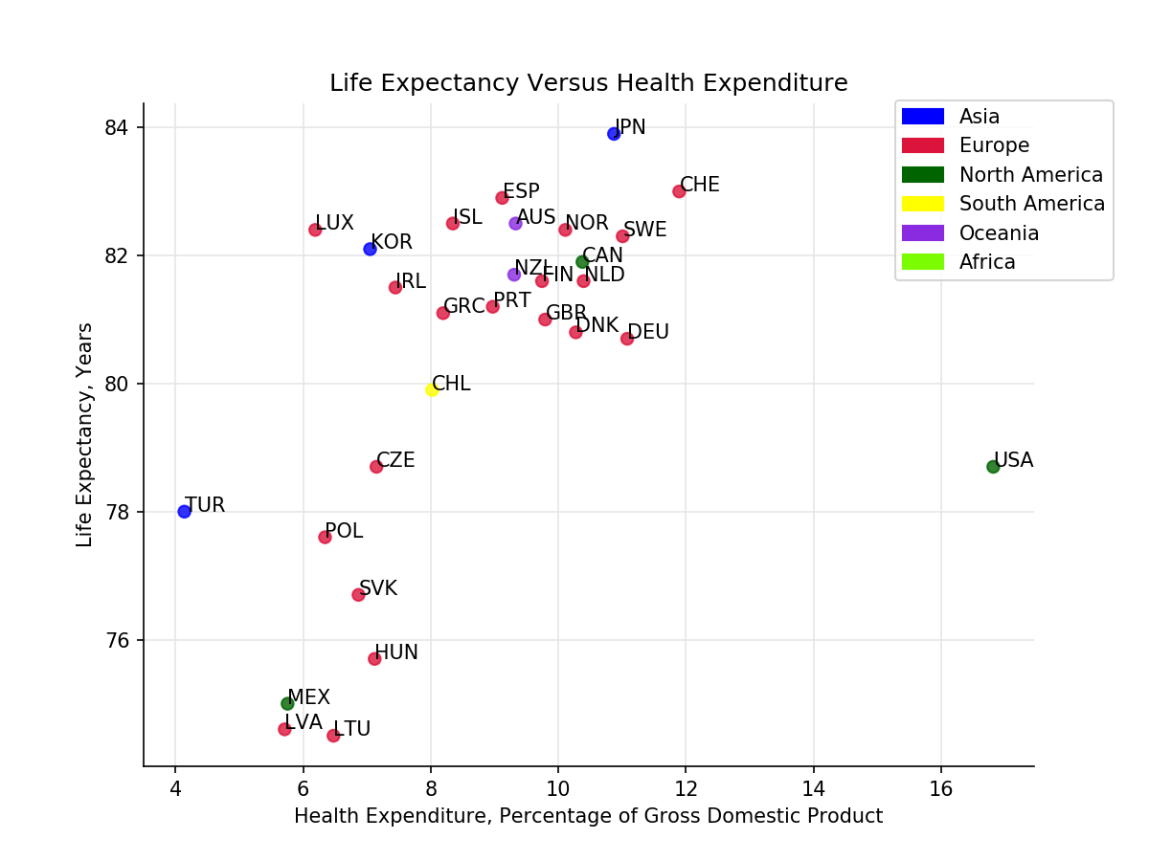
Life Expectancy versus Health Expenditure (Year 2015)
Overall, positive correlation
Outliers: Turkey and USA
Many different European countries that all somewhat follow the trend
Positive correlation for European countries
Reference [1]

Slide 8
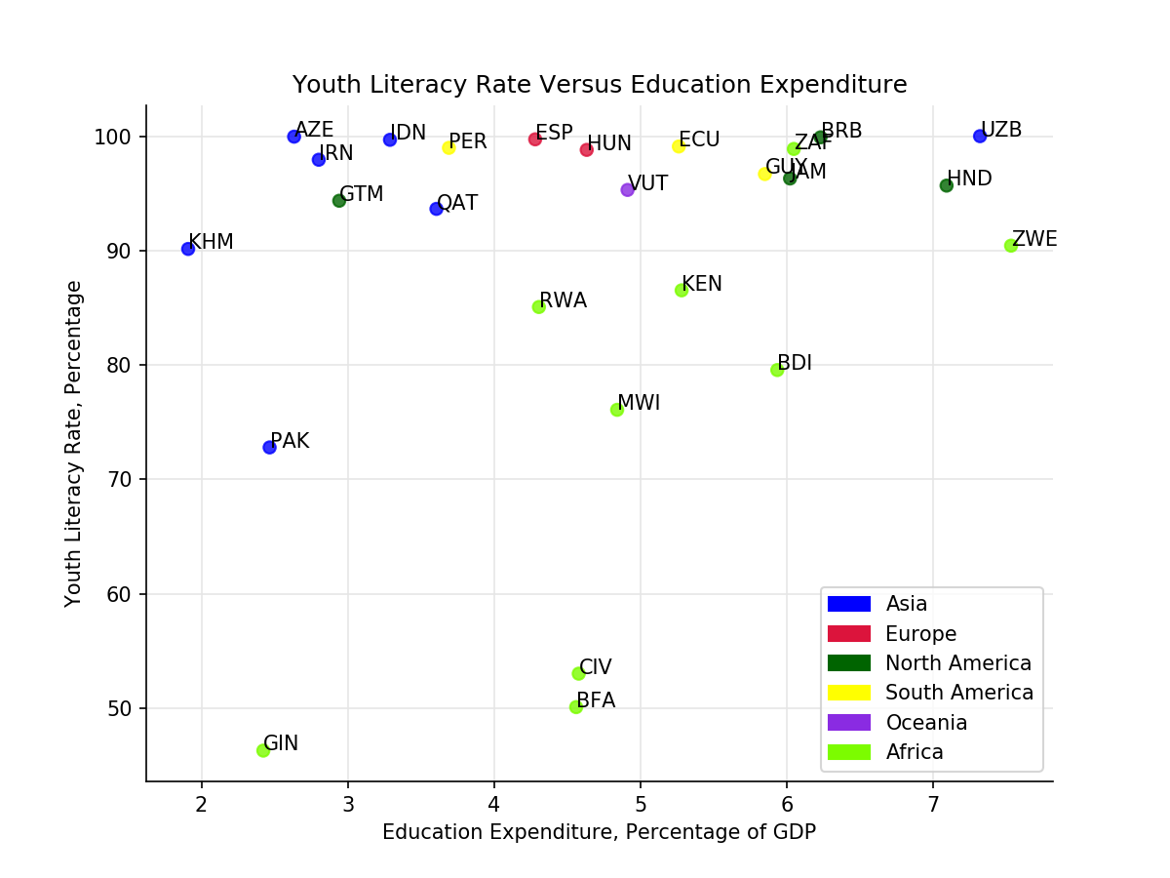
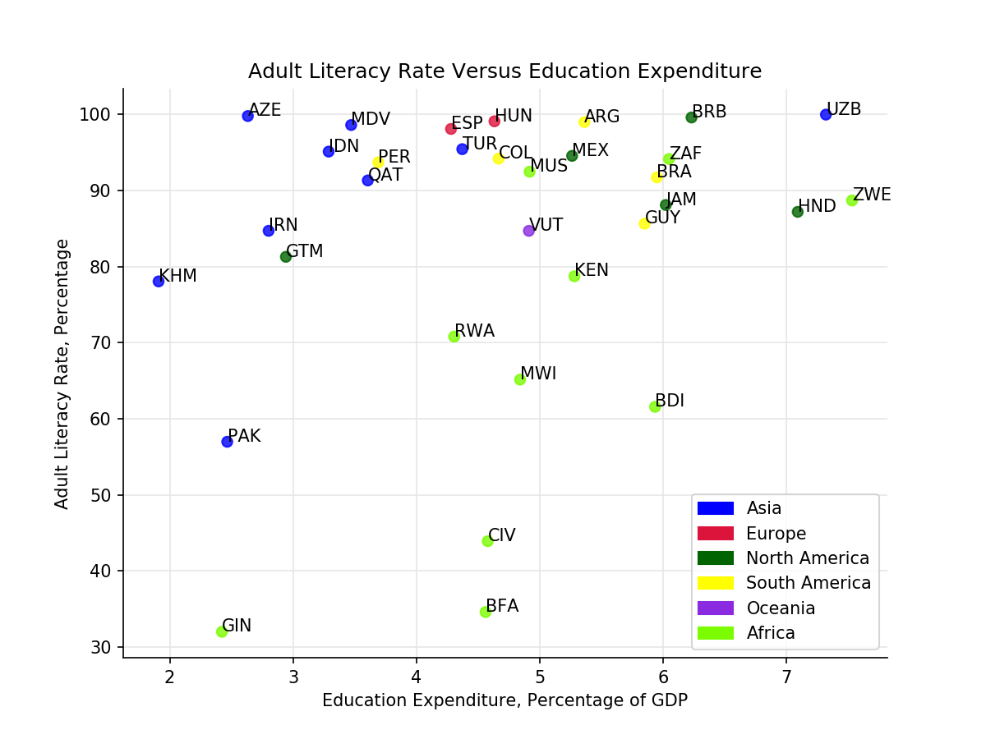
Literacy Rate versus Education Expenditure (Year 2014)
References: [2] & [4]
Notes:
For literacy rate above 95%
No correlation because other factors
For literacy rate below 90%
Positive correlation for Africa
More countries with <90% for adult literacy rate than there are countries with <90% for youth literacy rate

Slide 9
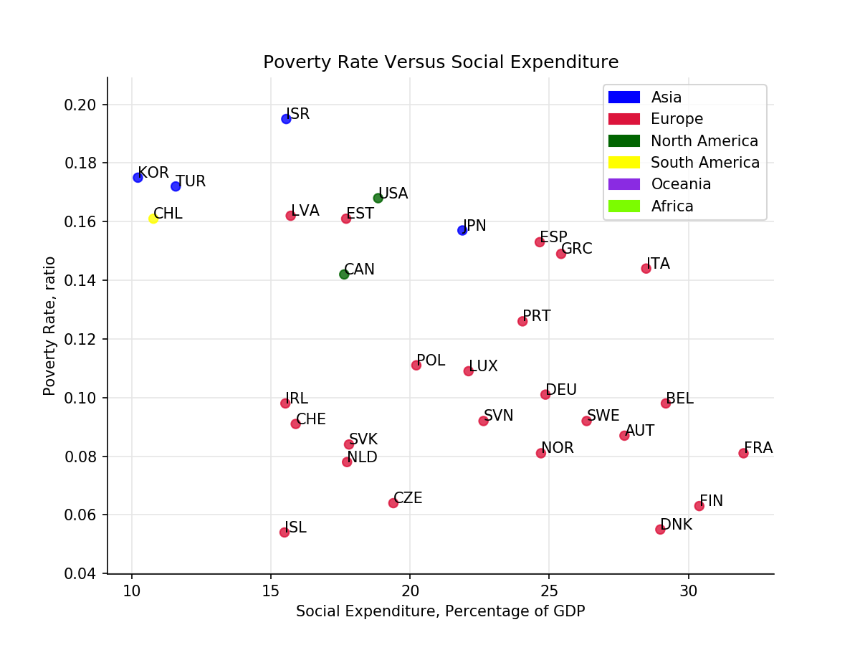
Poverty Rate versus Social Expenditure (Year 2015)
Weak negative correlation
European countries spend more and have lower poverty rate
References: [5] & [6]

Slide 10
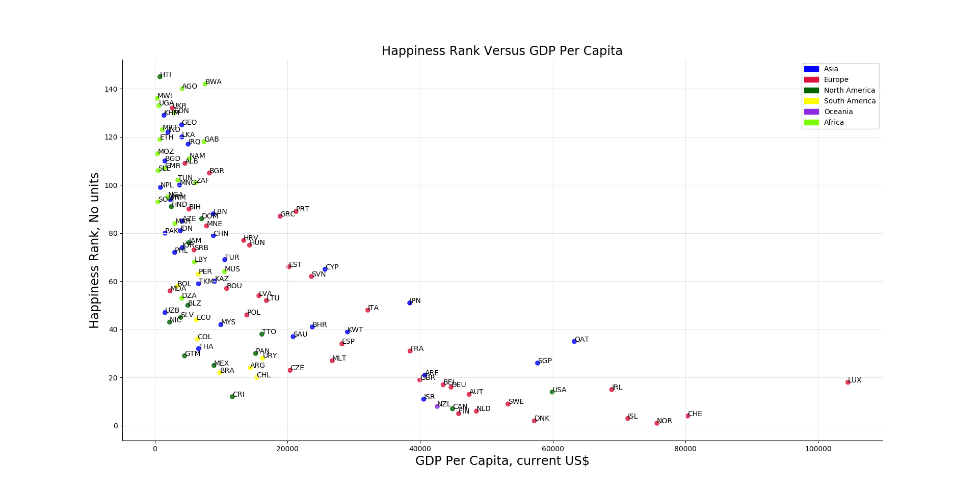
Standard of Living versus Happiness Rank (Year 2015)
Decaying exponential
Higher GDP per capita --> better rank (lower number for rank)
Quite a few countries have high happiness rank relative to standard of living
References: [7] & [8]

Slide 11
Conclusions
European Countries spend more per person
Governments’ priorities vary
Life Expectancy versus Health Expenditure : USA is an outlier
Literacy Rate versus Education expenditure: no correlation
Poverty versus Social Expenditure : weak negative correlation
Standard of Living versus Happiness Rank : weak correlation
Notes:
Interestingly, each of multiple plots had no correlation
Plotting scatter plots allowed viewing of raw data
Literacy rate relatively independent of education expenditure
Exceptions: countries with low literacy rates
CORRELATION DOES NOT IMPLY CAUSATION…
But correlation sure does say something
U.S.A. is an outlier

Slide 12
References
Organization for Economic Co-operation and Development. Health expenditure and financing and Life expectancy. Retreived from https://stats.oecd.org/Index.aspx?DataSetCode=SHA.
UNESCO Institute for Statistics. Government expenditure on education, total (% of GDP). Retreived from http://api.worldbank.org/v2/en/indicator/SE.XPD.TOTL.GD.ZS?downloadformat=excel.
UNESCO Institute of Statistics. Education [Filters: Youth literacy rate, population 15-24 years, both sexes (%); all countries; all years]. Retreived from http://data.uis.unesco.org/Index.aspx?DataSetCode=EDULIT_DS&popupcustomise=true&lang=en#.
UNESCO Institute of Statistics. Education [Filters: Adult literacy rate, population 15+ years, both sexes (%); all countries; all years]. Retreived from http://data.uis.unesco.org/Index.aspx?DataSetCode=EDULIT_DS&popupcustomise=true&lang=en#.
Organization for Economic Co-operation and Development. Social Expenditure - Aggregated Data. Retreived from https://stats.oecd.org/Index.aspx?datasetcode=SOCX_AGG.
OECD (2019), Poverty rate (indicator). doi: 10.1787/0fe1315d-en (Accessed on 04 June 2019)
World Happiness Reports. https://www.kaggle.com/unsdsn/world-happiness or https://www.kaggle.com/unsdsn/world-happiness#2017.csv.
The World Bank. GDP per capita (current US$). https://data.worldbank.org/indicator/ny.gdp.pcap.cd.

